Slide 1
Edgar Allan Poe
Introduction to English Literature 04
March 31, 2025

Slide 2
Table of Contents
Edgar Allan Poe Bio
Point of View and Unreliable Narrator
Key Passages from “The Cask of Amontillado”

Slide 3
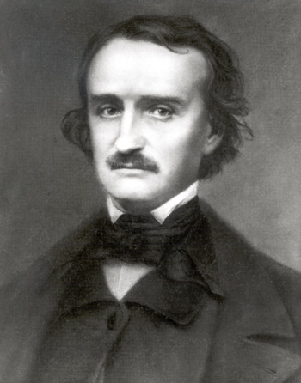
Edgar Allan Poe Biography
Born in Boston in 1809 as a son of itinerant actors who died in 1810 and 1811.
Taken care of by John Allan, a wealthy merchant of Richmond Virginia.
Went to school in England 1815-1820 and attended University of Virginia from 1826.
Allan wanted Edgar to pursue a legal career, but he fled to Boston.
A short army career and an attempt to become a professional military officer in West Point, soon dismissed for neglect of duty.
Editorship of literary magazine the Southern Literary Messenger 1835-37.

Slide 4
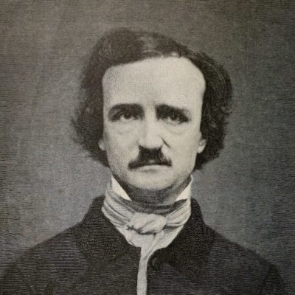
Edgar Allan Poe Biography
“The Narrative of Arthur Gordon Pym,” a dark nautical tale in 1837-38, in W. H. Auden’s words, “one of the finest adventure stories ever written.”
Co-editing in 1839-40 Burton’s Gentleman’s Magazine where he published ‘The Fall of the House of Usher,’ which was a rare immediate success.
Working for The New York Mirror during which he won literary prizes.
‘The Raven,’ his most popular piece of poetry in 1844.
Lived in poverty with Virginia his wife(his cousin 14 years younger than him) and mother-in-law without regular income and Virginia died of TB in 1847.

Slide 5
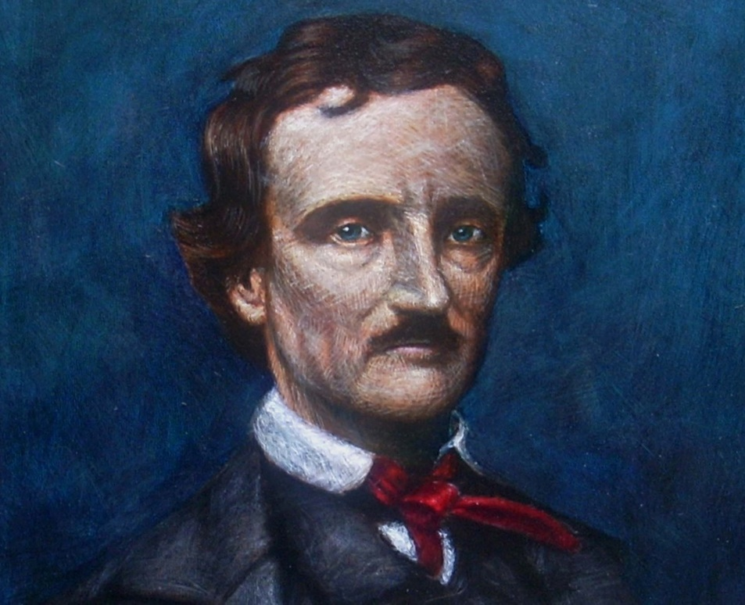
Edgar Allan Poe Biography
His belief in the beauty of melancholy.
Severely disturbed in his last years having a number of relationships with women.
Missing in Baltimore for 5 days and discovered in a delirium and died after a few days.
Buried in Baltimore next to his wife in 1849.
His literary reputation largely ignored or derided during his life time.
W. B. Yeats, George Bernard Shaw, Henry James and T. S. Eliot were his early admirers.

Slide 6
Point of View
The position or vantage-point from which the events of a story seem to be observed and presented to us.
Third-person narratives: omniscient and limited point of view.
First-person narratives: restricted to the narrator’s partial knowledge.
Multiple point of view.

Slide 7
Unreliable Narrator
A narrator whose account of events appears to be faulty, misleadingly biased, or otherwise distorted.
A sense of irony is created by the discrepancy between the unreliable narrator’s view of events and the view that readers suspect to be more accurate.
The unreliable narrator does not have to be morally untrustworthy or a habitual liar. Sometime they are harmlessly naïve, ‘fallible’, or ill-informed such as Huck in Mark Twain’s Adventures of Huckleberry Finn.

Slide 8
Questions about Narration and Point of View
Does the narrator speak in the first, second, or third person?
Is the story narrated in the past or present tense? Does the verb tense affect your reading of it in any way?
Does the narrator use a distinctive vocabulary, style, and tone, or is the language more standard and neutral?
Is the narrator identified as a character, and if so, how much does he or she participate in the action?
Does the narrator ever seem to speak to the reader directly (addressing “you”) or explicitly state opinions or values?
Do you know what every character is thinking, or only some characters, or none?
Does the narrative voice or focus shift durng the story or remain consistent?
Do the narrator, the characters, and the reader all perceive matters in the same way, or are there differences in levels of understanding(114)?

Slide 9
Motivation
The thousand injuries of Fortunato I had borne as I best could, but when he ventured upon insult, I vowed revenge. You, who so well know the nature of my soul, will not suppose, however, that I gave utterance to a threat. At length I would be avenged; this was a point definitely settled--but the very definitiveness with which it was resolved, precluded the idea of risk. I must not only punish, but punish with impunity. A wrong is unredressed when retribution overtakes its redresser. It is equally unredressed when the avenger fails to make himself felt as such to him who has done the wrong(p. 82/179).

Slide 10
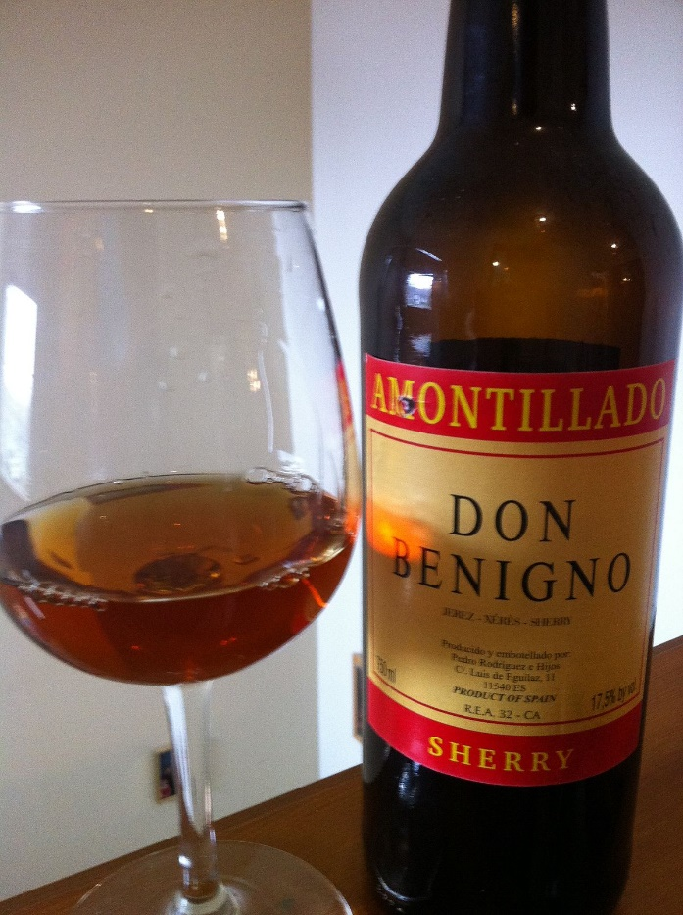
Manipulation
"As you are engaged, I am on my way to Luchesi. If any one has a critical turn, it is he. He will tell me--" "Luchresi cannot tell Amontillado from Sherry." "And yet some fools will have it that his taste is a match for your own." "Come, let us go(p.83/180)."
"Let us go, nevertheless. The cold is merely nothing. Amontillado! You have been imposed upon. And as for Luchresi, he cannot distinguish Sherry from Amontillado(p.83/180)."
I had told them that I should not return until the morning, and had given them explicit orders not to stir from the house. These orders were sufficient, I well knew, to insure their immediate disappearance, one and all, as soon as my back was turned(p.83/180).

Slide 11
Ironies and word-plays revealing the Narrator’s cruel nature
"I drink," he said, "to the buried that repose around us.“
"And I to your long life(p.84/181)."
"I forget your arms." "A huge human foot d'or, in a field azure; the foot crushes a serpent rampant whose fangs are imbedded in the heel." "And the motto?" "Nemo me impune lacessit." “Good!" he said. The wine sparkled in his eyes and the bells jingled. My own fancy grew warm with the Medoc(p.84/181).

Slide 12
Irony in a little bickering concerning Freemason
"You are not of the masons." "Yes, yes," I said; "yes, yes." "You? Impossible! A mason?" "A mason," I replied. "A sign," he said, "a sign." "It is this," I answered, producing a trowel from beneath the folds of my roquelaire a trowel(p.85/182).

Slide 13
The Narrator’s deceptive self-justification
"Pass your hand," I said, "over the wall; you cannot help feeling the nitre. Indeed, it is very damp. Once more let me implore you to return. No? Then I must positively leave you. But I must first render you all the little attentions in my power(p.85/182)."

Slide 14
The Narrator’s vindictive nature expressed without irony
The wall was now nearly upon a level with my breast. I again paused, and holding the flambeaux over the mason-work, threw a few feeble rays upon the figure within. A succession of loud and shrill screams, bursting suddenly from the throat of the chained form, seemed to thrust me violently back. For a brief moment I hesitated--I trembled. Unsheathing my rapier, I began to grope with it about the recess; but the thought of an instant reassured me. I placed my hand upon the solid fabric of the catacombs, and felt satisfied. I reapproached the wall; I replied to the yells of him who clamoured. I re-echoed--I aided--I surpassed them in volume and in strength. I did this, and the clamourer grew still(p.86/183).

Slide 15
Ending without Poetic Justice
For the half of a century no mortal has disturbed them. In pace requiescat(p.87/184)!
*May he rest in peace!

